Slide 1
Week 2 readings

Slide 2
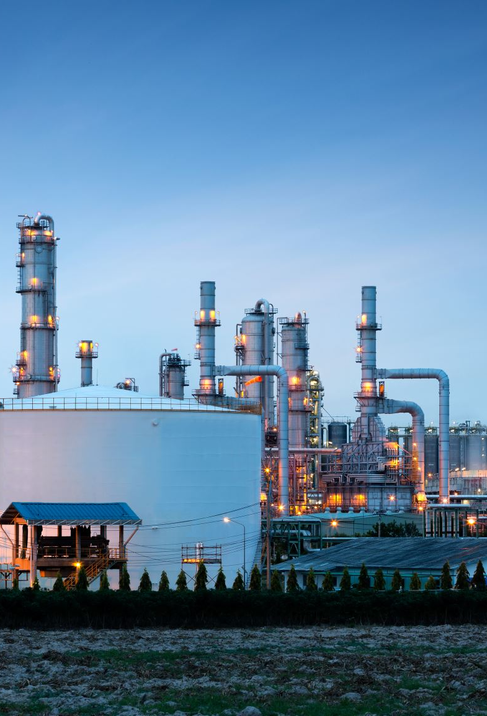
Main questions
Port ownership – what is the relationship like between port owner, port operator, etc
Examples of ships (Scandinavian vessels) that are currently running on hydrogen – what size ships are like this, what are their energy demands and storage capacities?
According to the energy consumptions of existing hydrogen vessels, what are the requirements of hydrogen production plants to match this?

Slide 3
Port Ownership
Port Harbour Authority (owner) are the owners of a specific port area and usually operate terminals within the port.
Non-landowning terminal operators operate individual terminals or wharves within a port area, sometimes under contract or concession from or part of a joint venture with the port owner.
In the context of the CMDC, the port owner (most likely private) will rent an individual terminal of a port to EGP or another hydrogen production company who are then expected to build the necessary infrastructure themselves.
Monios, J. (2017), ‘Port governance in the UK: Planning without policy’, Research in Transportation Business & Management, Vol 22, Pg 78-88, ISSN 2210-5395, doi: https://doi.org/10.1016/j.rtbm.2016.10.006

Slide 4
Case studies of existing hydrogen vessels

Slide 5
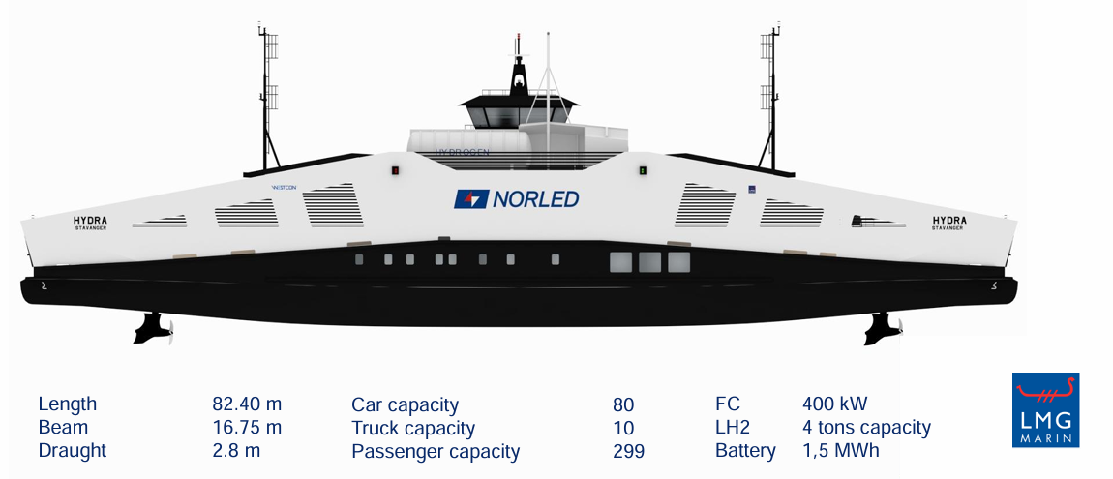
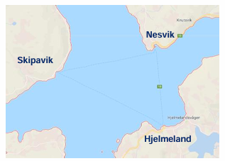
MF Hydra
The LH2 storage tank lasts for 12 days based on 100% FC operation with batteries handling peak loads.
Typical route is 11.5km but how long the storage lasts for depends on how many times the ferry travels along this route a day.
The LH2 storage tank lasts for 12 days based on 100% FC operation with batteries handling peak loads (assuming Hydra takes the route once a day).
4km
3km
4.5km
Norled_port_presentation_27.05.21.pdf (medias-ccifi.org)
MF HYDRA CAR FERRY NORWAY LIQUEFIED LIQUIDE HYDROGEN POWERED BALLARD FUEL CELLS NORLED (elizabethqueenseaswann.com)
Notes:
First LH2 (liquid hydrogen) fuel cell powered ferry that is currently operating in Norway.
Power system is composed of fuel cells (two stacks of 200kW each) and battery systems. Two 440kW diesel generators and a 1.36-1.5 MWh battery are also present on board. LH2 is stored in an 80m3 tank.
No information on how many times the Hydra travels along this route per day.

Slide 6
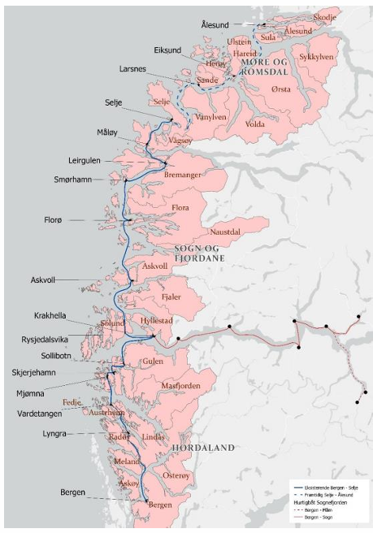
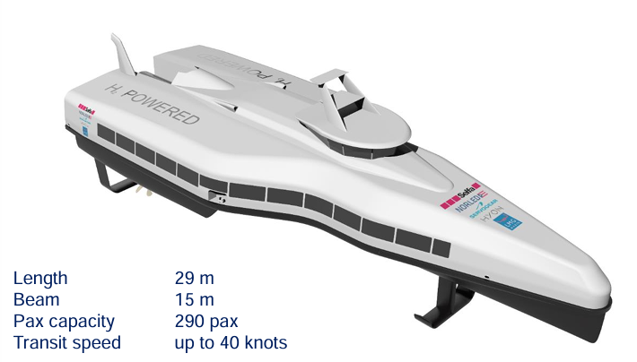
Future fast ferries
Future fast ferries in the Port of Bergen are estimate to consume 1 – 1.5 tons/day of H2 per ferry.
Norled_port_presentation_27.05.21.pdf (medias-ccifi.org)

Slide 7
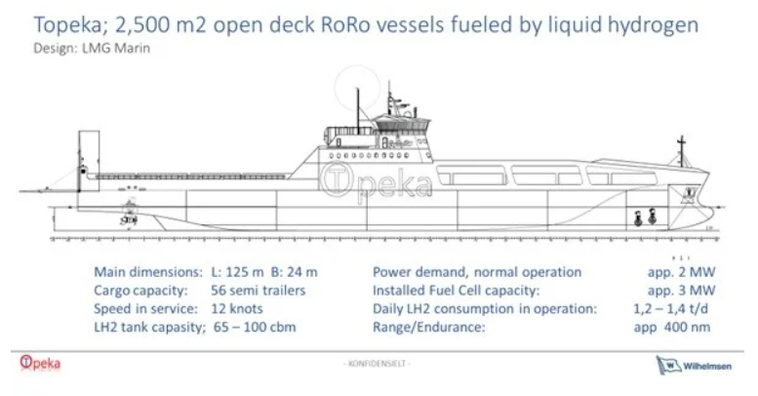
HySHIP: Topeka Prototype Vessel
Topeka will run on a 1MWh battery pack and a specialise 3MW proton exchange membrane hydrogen fuel cell charged by onshore.
The hydrogen will be produced via electrolysis, powered by renewable electricity from Norway’s national grid.
Possible limitations:
Hydrogen is liquefied by cooling it down to -252 degrees, which is complex and energy-intensive.
LH2 is also difficult to store and experience with LH2 in a distributed energy system is lacking, as is the requisite infrastructure.
https://www.ship-technology.com/features/hydrogen-vessel/?cf-view
Notes:
Also enquired about MS Skulebas which is the first fishing vessel that will sail on green hydrogen using a hydrogen-powered fuel cell in combination with a battery pack but I haven’t heard back from Jorgen and Stig who are the project managers of the Skulebas-project.

Slide 8
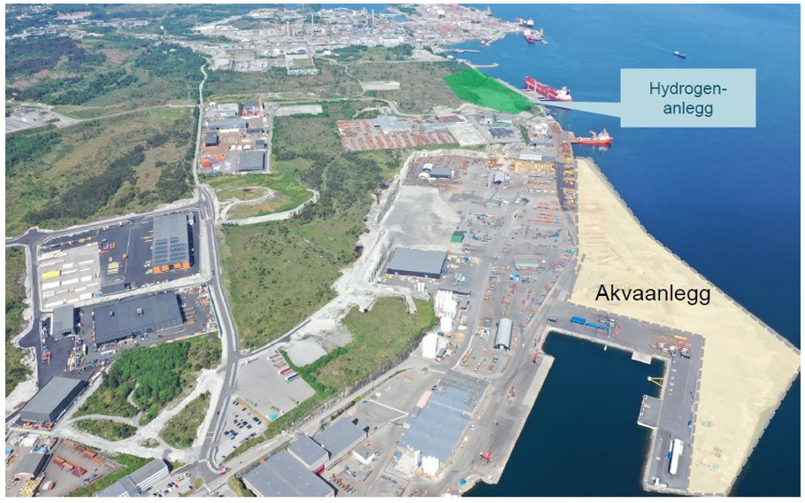
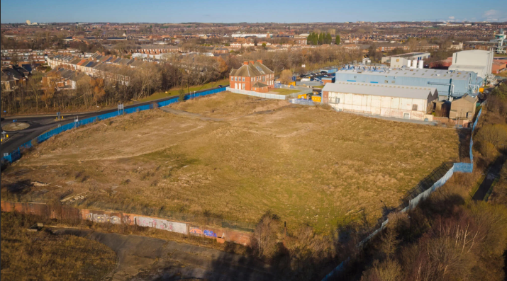
Hydrogen production requirements to power hydrogen vessels
For the MF Hydra and future fast ferries, Norway aims to provide the hydrogen for these from a green hydrogen production plant in Mongstad which aims to produce 6 tons/day.
6 tons would be sufficient to power MF Hydra for 18 days (dependent on distance travelled per day) or 6-4 fast ferries for a day.
Applying this to a UK context, a proposed green hydrogen plant by Lhyfe aims to produce 8 tons/day.
Mongstad production plant proposed site
Lhyfe production plant proposed site in Wallsend
https://www.lhyfe.com/press/lhyfe-launches-its-first-uk-project-with-plans-for-20mw-green-hydrogen-plant/
Notes:
Although this would be sufficient to power a handful of passenger ferries, the task becomes increasingly more challenging for a larger fleet or for cargo ships with huge energy consumptions.
The Lhyfe plant will occupy 4 acres of land and therefore upscaling the capacity of hydrogen production will require more land, as well as more land for renewable energy farms to power the plant.

Slide 9
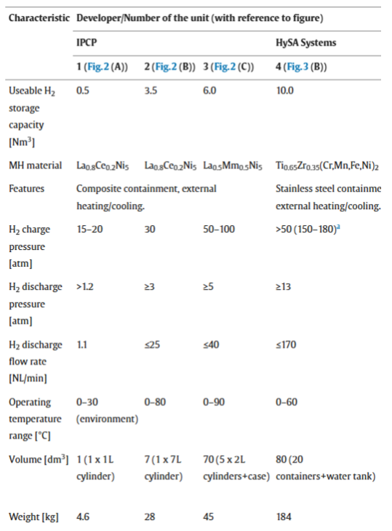

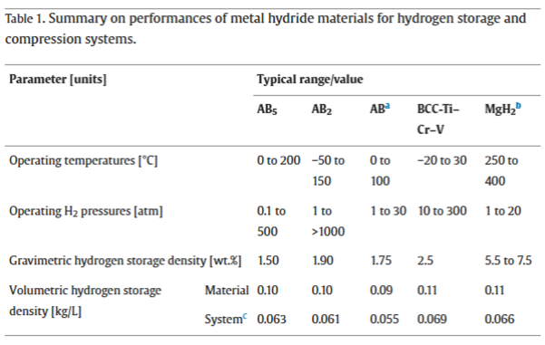


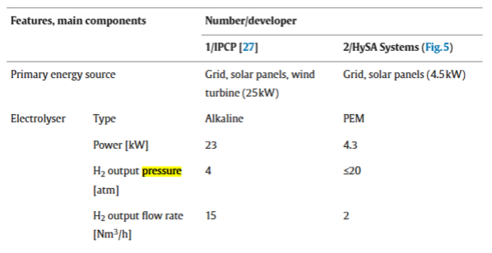

Metal hydride storage
MH storage capacities depend on the material used, the temperature, and the pressure.
Very complicated and lots of dependencies:
What type of storage you want depends on its purpose.
The higher the storage capacity, the higher the charge pressure, discharge pressure, and discharge flow rates.
https://www.sciencedirect.com/science/article/pii/S2352152X23018534
https://www.sciencedirect.com/science/article/pii/S0360319920326604?casa_token=pJ1_xR7zAhkAAAAA:Kom6Z9J5ufWXaq6IbY_iD1mc3Pj9E7nLrFhOLu7fKguwE_n6SKPk1UwFvgLAb3ApzG0O4lt1#tbl3
Notes:
For mobile applications such as shipping, the weight of the storage matters a lot because ships require a lot of hydrogen to be operational and heavy storage containers will affect the load capacity of cargo ships, which will have an effect on the economic feasibility of hydrogen usage.
Unsure how charge pressure, discharge pressure, and discharge flow rates affect the usage of hydrogen. (ask Charlie).
From my understanding, for MH storage, if the charge pressure is higher than the output pressure provided by the electrolyser, then hydrogn compression is needed which contributes to further energy demands and affects technical feasibility.
Explain graphs: Using the usable hydrogen storage capacity (1Nm3 = 1000L). Multiply 0.10 with the value to get kg of Hydrogen stored by these systems.
IPCP uses standard composite cylinders (carbon- or glass-fibre wounded stainless steel liner) as a containment heated and cooled from the outside by natural air convection or flow of heating/cooling liquid. In the case of liquid the containment is enveloped in a steel jacket. This method is light-weight, simple, and inexpensive but is characterised by a poor heat exchange between the MH and the fluid that results in rather slow H2 charge and discharge.
HySA use multiple MH containers ~40mm in diameter equipped with copper fins and heated/cooled from the outside. This solution is more labour-consuming and expensive, but it significantly increases H2 supply rate to the fuel cell stack whose fuelling system is thermally coupled with the heating system of the MH tank.

